Slide 1



Practice
AEA Developers student club
C++ & Problem-solving Course
25-11–2024

Slide 2
CONTENT
01
Revision
Problems with new idea
04
02
Simple problems
05
Hard problems
03
Up solve Assignment

Slide 3
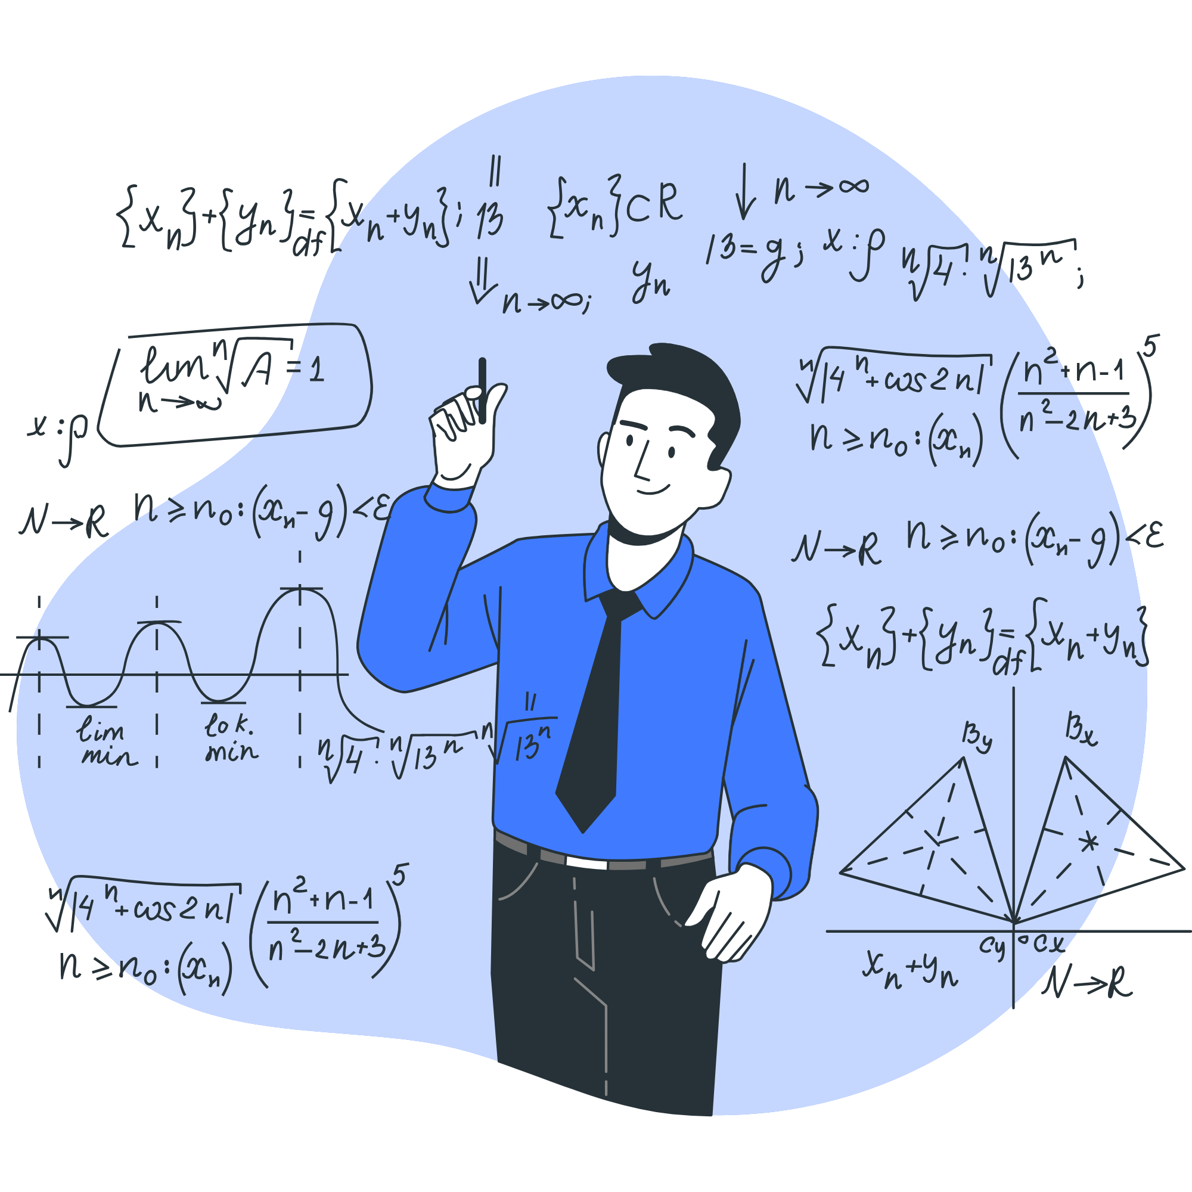
01
Revision

Slide 4




Effective Problem-solving Techinque
01
Understand the problem
Debagging the code
04
02
Analyze the problem
05
Find solutions online
03
Prepare a solution plan

Slide 5

02
Simple problems

Slide 6
Problem 1
Input
Only one line containing the following space-separated values: int, long long , char, float and double respectively.
Output
Print each element on a new line in the same order it was received as input.
Test cases
3 12345678912345 a 334.23 14049.30493
3 12345678912345 a 334.23 14049.3

Slide 7
code

Slide 8
Problem 2
Given four numbers A, B, C and D. Print the result of the following equation :X = (A * B) - (C * D).
Input
Only one line containing 4 separated numbers A, B, C and D ( - 105 ≤ A, B, C, D ≤ 105).
Output
Print "Difference = " without quotes followed by the equation result.
Test cases
1 2 3 4
Difference = -10
4 5 2 3
Difference = 14
2 3 4 5
Difference = -14

Slide 9
code

Slide 10
03
Up solve Assignment

Slide 11
Casting
Casting is a conversion process wherein data can be changed from one type to another.
Ex.
Int x=10;
Float y=x;
y = 10.00;
Ex.
Float x=15.5;
Int y=x;
y = 15;
Int | + | Int | Int
Int | - | Int | Int
Int | * | Int | Int
Int | / | Int | Int
Int | + | Float | Float
Int | - | Float | Float
Int | * | Float | Float
Int | / | Float | Float

Slide 12
code
A.Problem 1

Slide 13
code
A.Problem 2

Slide 14
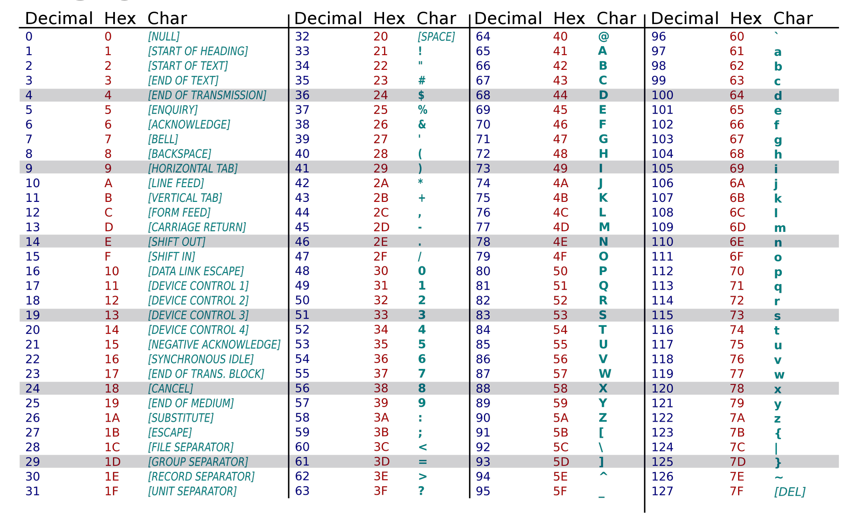
ASCII Table

Slide 15
code
A.Problem 3

Slide 16
price before discount = Discount value + price after discount
suppose
price before discount=x
Discount value=(x*p%)
price after discount =y
x=(x*p%)+y
100x=px+100y
x(100-p)=100y
x=100y/(100-p)
Note
P%=P/100
x=(x*p%)+y *100

Slide 17
code
A.Problem 4

Slide 18
code
A.Problem 5

Slide 19
Swap Method

Slide 20
code
A.Problem 6

Slide 21
04
Problems with new idea

Slide 22
Problem 3
Given 2 numbers A and B . Print floor , ceil and round of A/B
Note:
1.Floor: Is a mathematical function that takes a real number X and its output is the greatest integer less than or equal to X .
2.Ceil: Is a mathematical function that takes a real number X and its output is the smallest integer larger than or equal to X.
3.Round: Is a mathematical function that takes a real number X and its output is the closest integer to that number X.
Input
Only one line containing two numbers A and B(1≤A,B≤10^3)
Output
Print 3 lines that contain the following in the same order:
1."floor A / B = Floor result" without quotes.
2."ceil A / B = Ceil result" without quotes.
3."round A / B = Round result" without quotes.

Slide 23
Test cases
10 3
floor 10 / 3 = 3 ceil 10 / 3 = 4 round 10 / 3 = 3
10 4
floor 10 / 4 = 2 ceil 10 / 4 = 3 round 10 / 4 = 3
900 40
floor 900 / 40 = 22 ceil 900 / 40 = 23 round 900 / 40 = 23

Slide 24
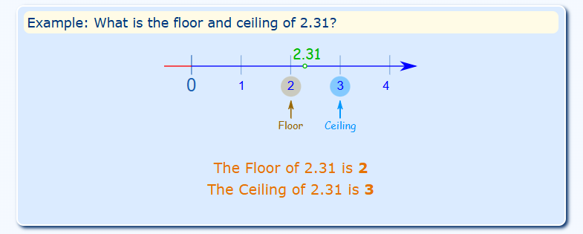
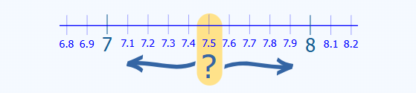
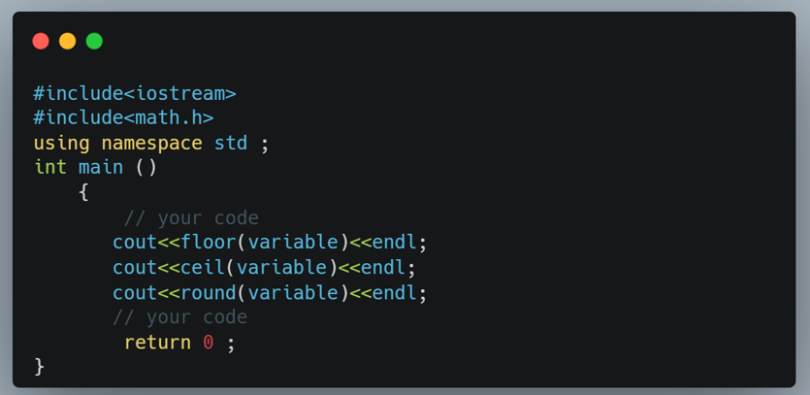
Floor & ceil
Round
syntax

Slide 25
code

Slide 26
Problem 5
=Given a number R calculate the area of a circle using the following formula:
Area π * R².
Note: consider π = 3.141592653.
Input
Only one line containing the number R (1 ≤ R ≤ 100).
Output
Print the calculated area, with 9 digits after the decimal point.
Test cases
2
12.566370612
5
78.539816325
65
13273.228958925

Slide 27
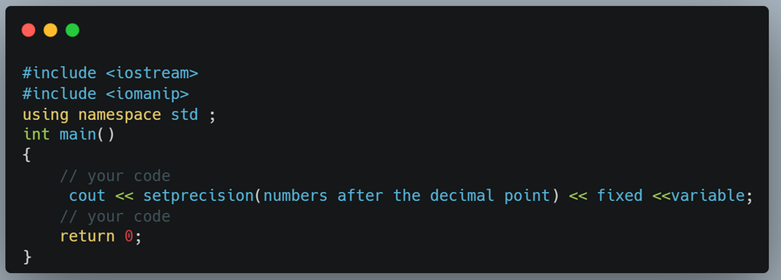
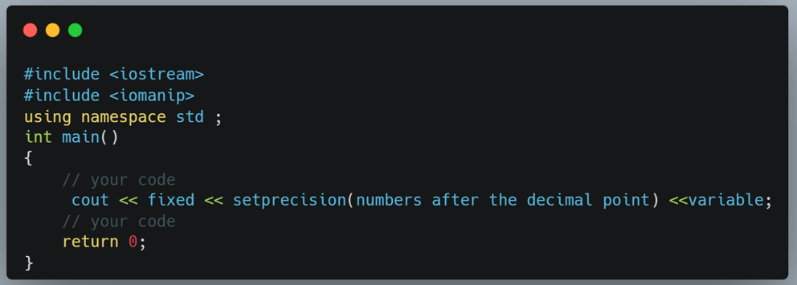
Method 1
Method 2

Slide 28
code

Slide 29
05
Hard problems

Slide 30
Problem 6
Given a number N . Print the summation of the numbers that is between 1 and N (inclusive).
Input
Only one line containing a number N
(1≤N≤10^9)
Output
Print the summation of the numbers that are between 1 and N (inclusive).
Test cases
3
6
10
55
1000000
500000500000
102600568
5263438328261596

Slide 31
If number =10
suppose
result=1+2+3+4+5+6+7+8+9+10
result=10+9+8+7+6+5+4+3+2+1
2 result=11+11+11+11+11+11+11+11+11+11
2 result=11(1+1+1+1+1+1+1+1+1+1)
2 result=11*10
result=(11*10)/2
result=110/2=55
result=(number*(number+1))/2
+

Slide 32
code

Slide 33

“If we can do it, wonderful. If we can’t do it, let’s fail in the most beautiful way.”
Jürgen Klopp

Slide 34


Thank You
For Your Attention.

